Slide 1
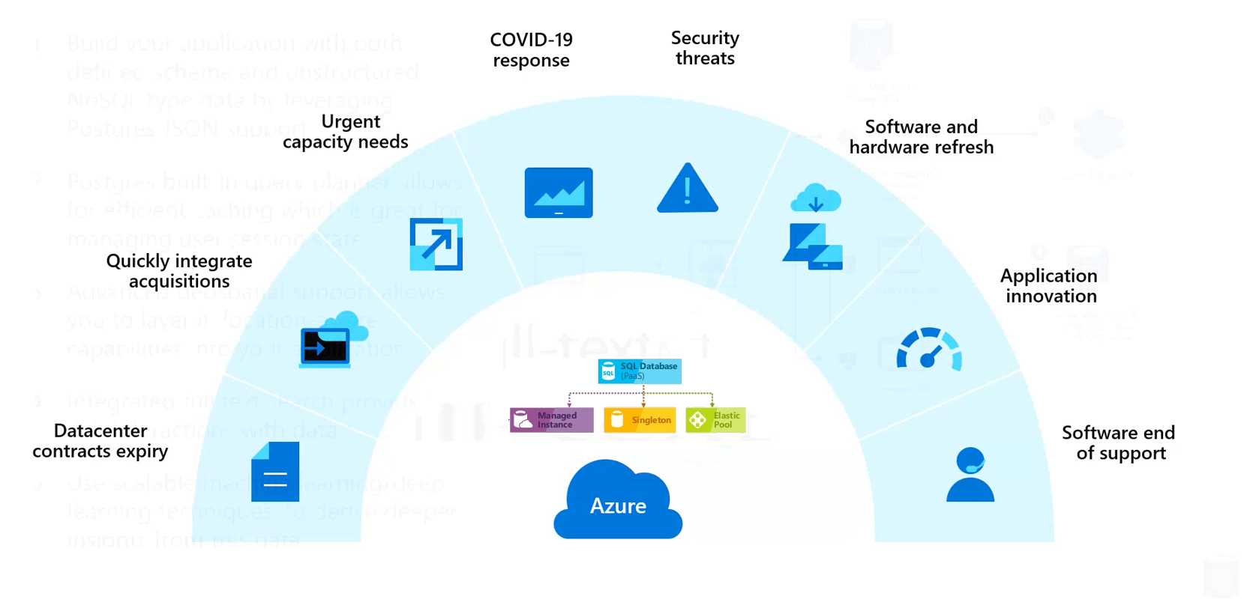
Cloud Migration Triggers

Slide 2
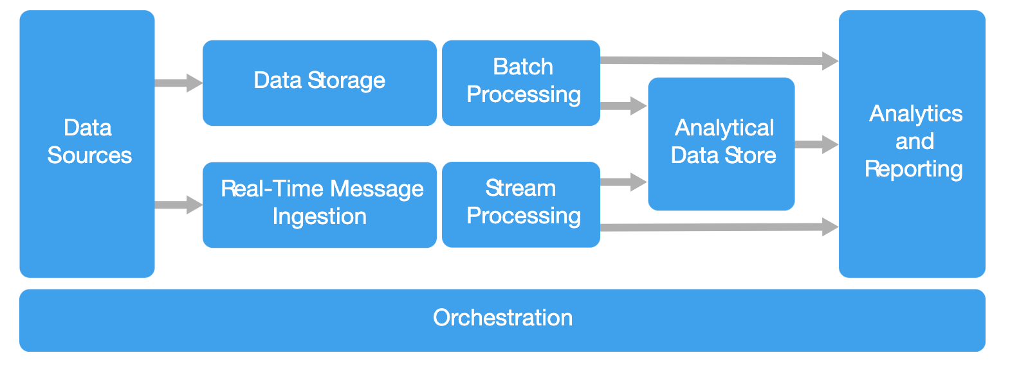
What is Azure Synapse Analytics?
https://docs.microsoft.com/en-us/azure/architecture/guide/architecture-styles/big-data

Slide 3

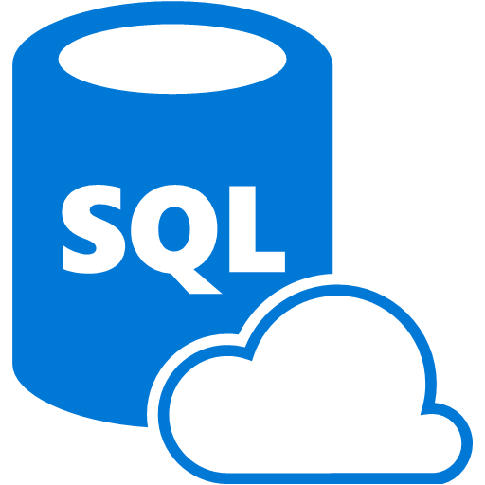
































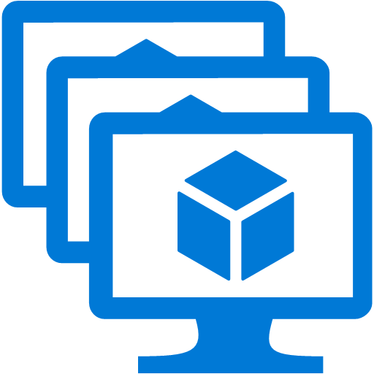



























Platform Services
Security & Management
Hybrid
Cloud
Media & CDN
Application Platform
Data
Security Center
SQL
Database
Azure AD
Health Monitoring
Media Services
Media Analytics
Content Delivery
Network
Web
Apps
Mobile
Apps
Azure
Synapse
DocumentDB
Portal
AD Privileged
Identity
Management
Azure Active
Directory
Integration
SQL Server
Stretch Database
Redis
Cache
Storage
Tables
Azure
Search
API
Apps
Cloud
Services
Azure AD
B2C
API
Management
BizTalk
Services
Domain Services
Service
Fabric
Notification
Hubs
Intelligence
Multi-Factor
Authentication
Logic
Apps
Service Bus
Functions
Cognitive Services
Bot Framework
Cortana
Backup
Automation
Developer Services
Analytics & IoT
Operational
Analytics
Compute Services
Scheduler
HDInsight
Machine
Learning
Stream Analytics
Container
Service
VM
Scale Sets
Visual Studio
Mobile
Engagement
Import/Export
Key Vault
Data
Catalog
Data Lake
Analytics Service
Data Lake Store
Store/
Marketplace
Batch
RemoteApp
VS Team Services
Xamarin
Azure Site
Recovery
Application
Insights
HockeyApp
IoT Hub
Event
Hubs
Data
Factory
Power BI
Embedded
VM Image Gallery
& VM Depot
Dev/Test Lab
StorSimple
Infrastructure Services
Compute
Storage
Networking
Virtual Machines
Containers
Blob
Queues
Files
Disks
Virtual Network
Load Balancer
DNS
Express
Route
Traffic Manager
VPN Gateway
App
Gateway
Datacenter Infrastructure
Notes:
SQL Operates in this environment – Part of the entire infrastructure
Security, Blob storage, ADF, AI, Storage, compute Over the infrastructure
The key point is that it is an integrated platform.
You have to know a little about a lot – at a minimum
We are coverying SQL DW in this session.
Anyone getting their certifications?
Pick List?

Slide 4
Modern Data Warehouse
INGEST
PREPARE
TRANSFORM & ENRICH
SERVE
VISUALIZE
STORE

Slide 5
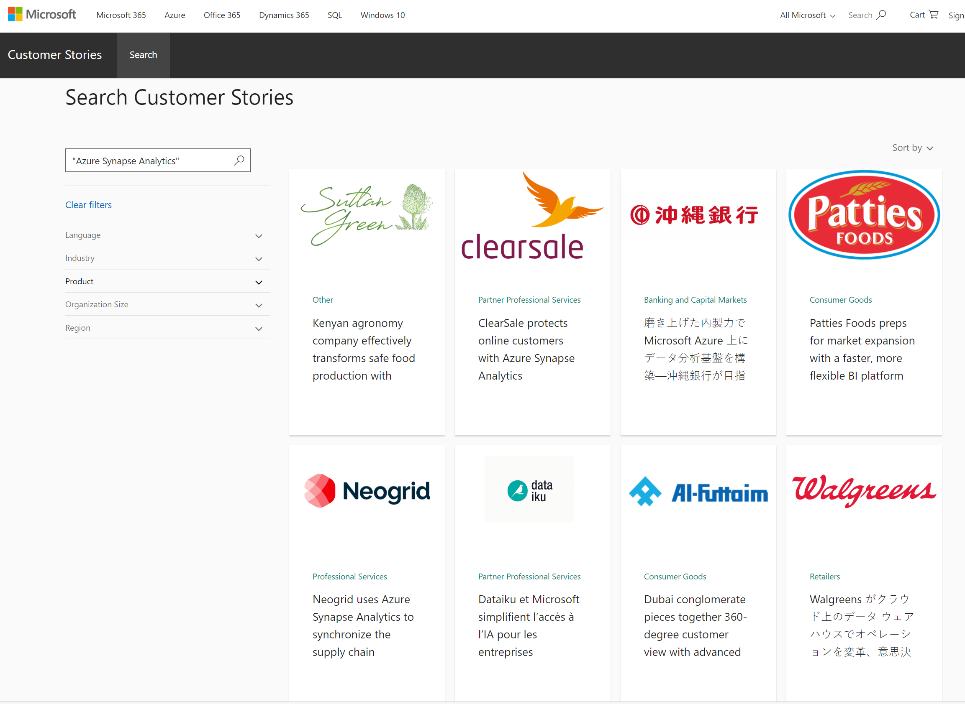
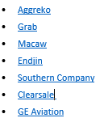
Case Study
Customer Stories Online
A Listing of Case Study Videos will be provided as a takeaway.
https://customers.microsoft.com/en-us/search?sq=%22Azure%20Synapse%20Analytics%22&ff=&p=2&so=story_publish_date%20desc

